Slide 1
DSI × DENODO DATA CATALOG
Step 0 — Layer-3 Resource Probe
An empirical scan of all 15,007 active views on dev — answering “do layer-3 resources exist, and where do they live?” before locking the DSI schema.

Slide 2
MOTIVATION
“Of the ~15,000 views on dev, N have layer-3 resources, distributed across these metadata fields.”
1
Schema decision pending
Should the DSI backend include a dedicated resources / attachments field? Guessing risks either dead weight or a missing capability.
2
No documentation answers this
The Data Catalog exposes no “attachments” concept in its API docs — only an empirical scan of real metadata can tell us what exists.
3

Slide 3
METHOD
Three-step probe over the live API
1 · ENUMERATE
2 · INSPECT
3 · RECORD
GET /public/api/views?serverId=1
GET /public/api/view-details
SQLite · probe_results.db
One call returns all elements; filtered client-side to database dataportal, skipping deleted views → 15,007 active views.
Per view, keyed on (viewName, databaseName, serverId). Scan propertyInfo maps + description for three signal types: URLs in RICH_TEXT (extracted from raw HTML before stripping), resource-suggesting property names, explicit attachment fields.
Every hit saved as (view, signal_type, property, evidence); checkpoint table makes the sweep fully resumable — interrupted and resumed across office and home sessions.
Politeness & resilience: OAuth (Authorization Code) with automatic token refresh across the ~5-hour total runtime · 6 concurrent workers (within the 4–8 limit for the shared dev server) · pooled TLS connections · exponential-backoff retries · checkpoint every 500 views.

Slide 4
EXECUTION NOTES
The probe verified the API contract along the way
Dev ≠ prod schemas
view-details params verified
The list endpoint returns db on dev but databaseName on prod — one more entry in the known dev/prod drift (15,007 vs ~4,418 views). The client now handles both.
Correct request keys are viewName, databaseName, serverId — confirmed via Swagger after the documented guesses returned 401. Stateless Bearer auth works on every endpoint; no session dance required.
Properties live in propertyInfo
12 views are un-probeable
Values sit under summaryPropertyMap groups as visualValue (HTML for RICH_TEXT). URLs live inside href attributes — so extraction runs on raw HTML before tag-stripping.
All follow the vlanl*task naming pattern and consistently return HTTP 500 — a systematically broken view family on dev worth reporting as a data-quality finding (coverage: 14,995 / 15,007 = 99.9%).

Slide 5
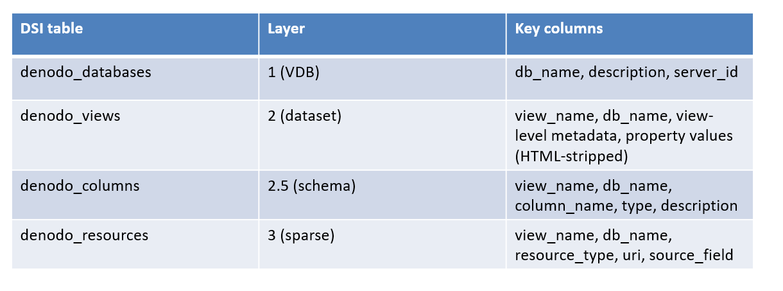
The ideal Tri-layer Model:

Slide 6
RESULTS
“Of the ~15,000 views on dev, N have layer-3 resources, distributed across these metadata fields.”
15,007
5,366
829
544
100%
▸
35.8%
▸
5.5%
▸
3.6%
active views probed
carry any layer-3 signal (incl. contact links)
contain any embedded URL
carry a verified documentation link
Headline for the meeting: layer-3 metadata exists on a third of views — but only 544 views (1 in 28) link to genuine documentation.

Slide 7
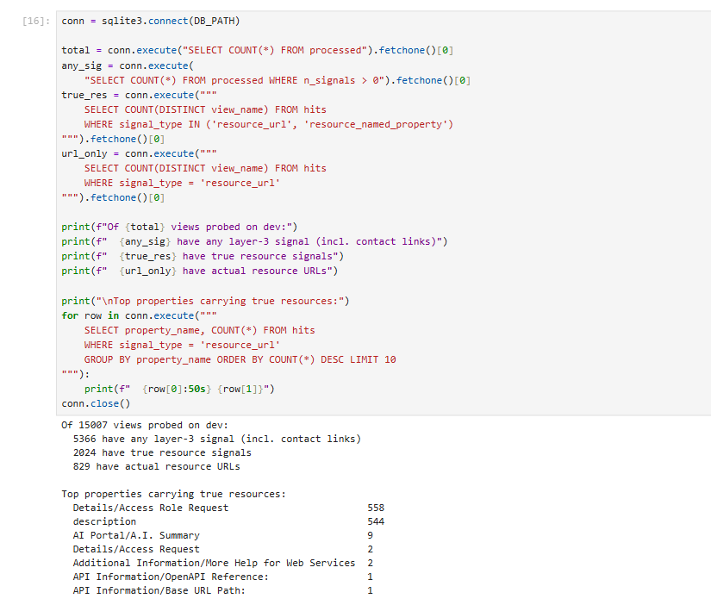




Slide 8
RESULTS
What kind of signals? Mostly people, not documents
11,901 signals total
79% are contact links
Primary Point of Contact (5,084) and Data Owner (4,351) — links to the LANL people directory, not documents. Counted separately so they don't inflate the resource number.
~1.8 links per view
9,436 contact links across 5,167 views — the POC + Data Owner pattern seen on nearly every populated view.
Verified: ODS DB Link is lineage
1,347 of 1,348 “resource-named” hits are one property matched on the word Link. Verified: values are Oracle DB-link identifiers (EBS_LINK 63%, SNFLWR_LINK, ARIBA_LINK; 0 of 1,347 contain a URL; 182 literally say NOLINK) — excluded from Layer 3, promoted to Layer-1 source_system.

Slide 9
VERIFICATION
Where the URLs actually point
Details / Access Role Request · 558 URLs
description (free text) · 544 URLs
93% → LANL's access-request portal. These are access instructions, not documents — excluded from Layer 3, mapped to a dedicated access_instructions field.
86% → Oracle table-reference docs. Each view links to its own source table's data-dictionary page — genuine documentation, exactly 1 URL per view (544 URLs / 544 views).

Slide 10
INTERPRETATION
Metadata richness is clustered, not uniform
Long flat stretches
Views 500–3,000 added almost nothing (5 → 35) — entire alphabetical families carry no layer-3 metadata at all.
Sharp bursts
Views 3,500–5,000 exploded from 179 to 1,359 — specific view families / business units maintain rich metadata.
Backend implication
Layer-3 presence cannot be assumed. The DSI backend must treat resources as sparse, optional data — present on some sources, absent on most.
Cumulative resource-bearing views over the main sweep (views processed ≈ alphabetical order)

Slide 11
SYNTHESIS
Every probed field found its home in the tri-layer model
Catalog field
Destination in DSI schema
Verified evidence
ODS Details / ODS DB Link
Layer 1 · source_system
Oracle DB-link identifiers (EBS, Snowflake, Ariba) — lineage, not files. 182 values are literally NOLINK.
Primary POC / Data Owner
View metadata · contacts
9,436 people-directory links — the dominant layer-3 content is people; modeled as contacts, never as documents.
Details / Access Role Request
View metadata · access_instructions
93% point to accessit.lanl.gov — how to request access, repeated near-verbatim across views.
description → embedded URL
Layer 3 · documentation_url
544 views, exactly one link each; 86% Oracle table-reference docs. The only true Layer-3 population.
The probe did more than count — it reclassified every candidate field into the correct layer, with evidence.

Slide 12
CONCLUSIONS
“Of 15,007 active views on dev, 544 (3.6%) carry a genuine documentation link — one per view, 86% pointing to Oracle table-reference docs — embedded in the description field. No structured resource field exists; the DSI backend will harvest these at ingest.”
documentation_url — optional scalar
access_instructions + source_system
Model contacts separately

